Slide 1
Puppet Configuration Management Tool
Group-1
Lynn Let Htun
May Ei Zin
Soe Htet Naing
Su Nandar(1)

Slide 2
What is Puppet?
The platform that manages infrastructure.
Run in master-agent structure.
Open source software released under GNU General Public License (GPL )
Puppet was first released in 2005 .

Slide 3
Which organization use Puppet?
Google
Twitter
Sun
Sony
New York Stock Exchange
Slide Share

Slide 4
Why Puppet?
Provide secure mechanism for transporting the specific configuration from the server to hosts over HTTP with SSL authentication and encryption , the same SSL used to secure online banking and e-commerce.

Slide 5
Puppet Comes in two flavors
Open Source Puppet
Puppet Enterprise

Slide 6
Installation of Open Source puppet
Decide on a deployment type.
agent/master (client/server) architecture
Install and configure Puppet on any Puppet masters.
Master must be running some kind of *nix.
-Give Server name to the Puppet master.

Slide 7
Installing Puppet Agent
Download the agent puppet according to the OS.
Puppet agent can run in different kind of OS.
Run the following command :
sudo apt-get install puppet-agent.

Slide 8
Start the Puppet Service
Puppet agent send the certificate to puppet master .
Puppet master see the request and sign the certificate by running these command.
Run sudo /opt/puppetlabs/bin/puppet cert list to see any outstanding requests.
Run sudo /opt/puppetlabs/bin/puppet cert sign <NAME> to sign a request.

Slide 9
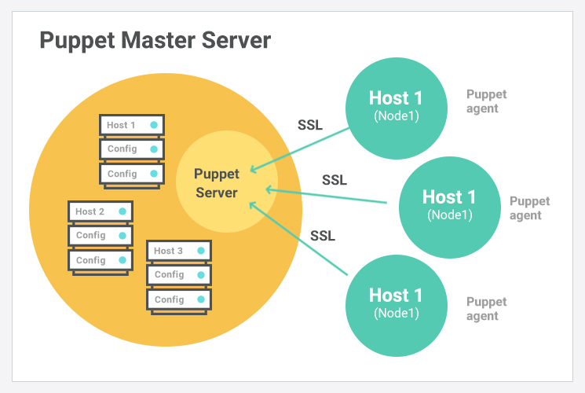
Infrastructure of Puppet

Slide 10
Checking Node Status
$ sudo puppet node status <NODE>
This will tell you whether the node is active,when its last catalog was submitted, and when its last facts were submitted.

Slide 11
Monitor the performance dashboard
http://<puppetdb server>:8080
PuppetDB uses this page to display a web-based dashboard with performance information and metrics, including its memory use, queue depth, command processing metrics, duplication rate, and query stats

Slide 12
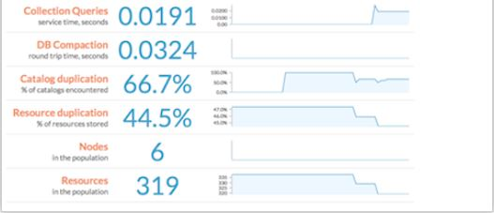
Monitor the performance dashboard

Slide 13
View the log
/var/log/puppetlabs/puppetdb/puppetdb.log

Slide 14
Push and Pull Configuration

Slide 15
Overview of Puppet
Infrastructure | Puppet Master synchronize configuration on each node
Require specialized software for node | Yes
Provide centralized point of control | Yes , via Puppet Master
Script Terminology | Manifests / Module
Task Execution order | Non-sequential

Slide 16
What are the advantages of puppet over other tools?
Puppet keeps on verifying the configuration at a specified interval(which you can modify as per requirement).
Puppet is used by major players in the industry like Google , red hat etc.
Larger open-source developer base .
Wide number of platforms are supported in puppet.
Its works very smooth, even when deployed in a large infrastructure(thousands of hosts to manage).

Slide 17
Thank You

